Slide 1
The Simultaneous Detection and Classification of Mass and Calcification Leading to Breast Cancer in Mammograms
Scott Gozdzialski, Ireti Fasere Alex Stern
Advisor: Daniel Engels

Slide 2
Abstract
Problem: The Simultaneous Detection and Classification of Breast Caner in Mammograms
Solution: Convolutional Neural Networks
Result 46% accuracy of detection with 64% properly classified

Slide 3
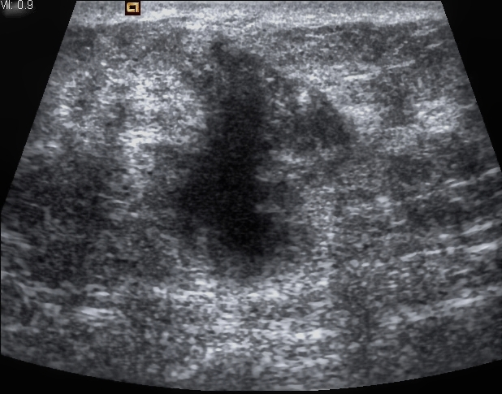
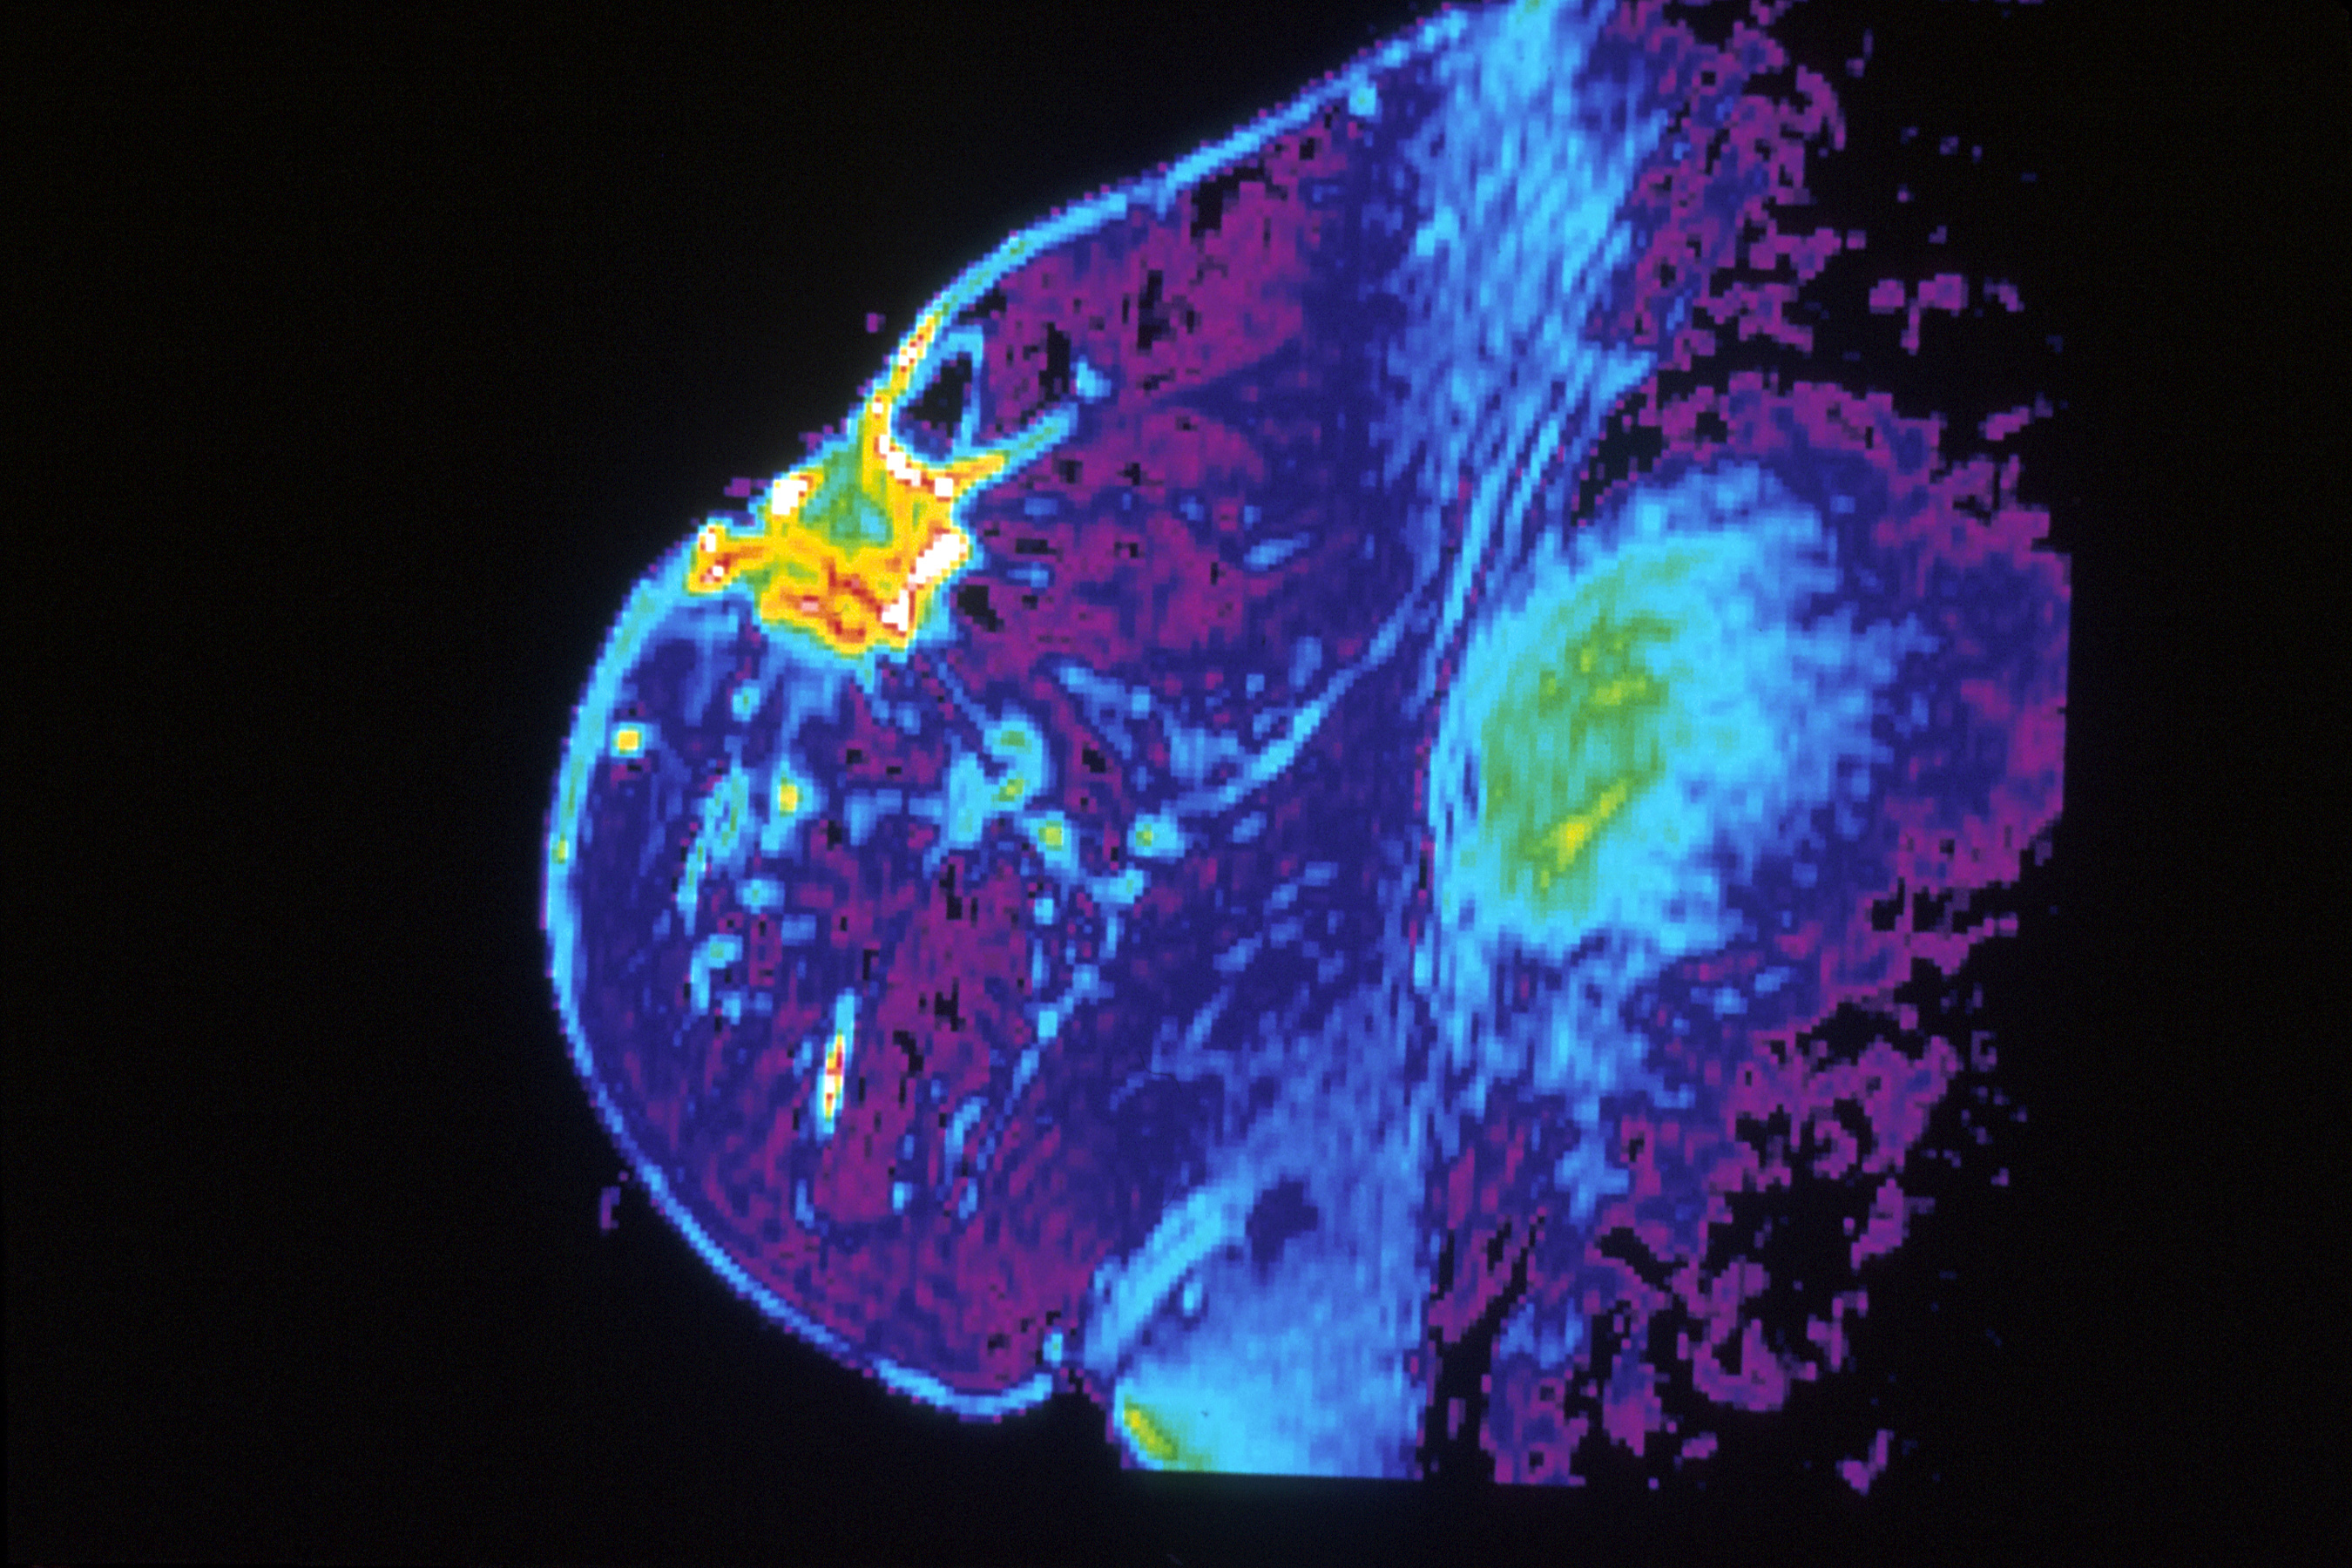
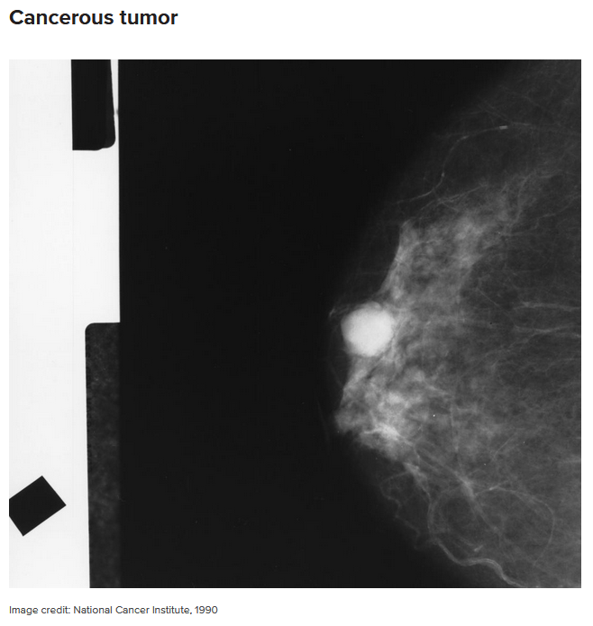
Introduction
1 in 37 Women die of breast Cancer, 2.7%
Tools of detection: Physical exam, Imaging, and Biopsy.
Imaging types: Mammogram, MRI, Ultrasound.

Slide 4
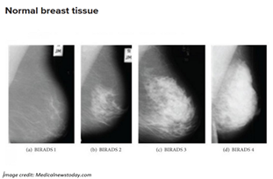
Background: Mammogram
X-Rays of the Breast
Normal Mammogram

Slide 5
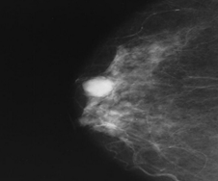
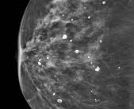
Background: Mammogram
X-Rays of the Breast
Abnormal – Mass
Abnormal - Calcification

Slide 6
Background: Mammogram
Interpretations
BI-RADS
Category | Interpretation
0 | Result unclear, needs further test, and previous mammogram comparison
1 | Abnormalities absent
2 | No cancer but presence of abnormalities like benign calcifications
3 | Abnormalities like benign present needs follow-up
4 | Abnormalities present could be cancerous, may need biopsy
5 | Abnormalities present likely to be cancerous, requires biopsy
6 | Presence of cancer requires a mammogram for progress.

Slide 7
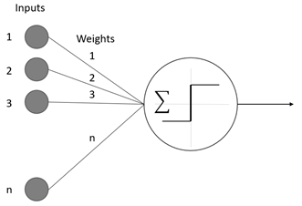
Background: Neural Networks
Built upon the Perceptron
Takes in many inputs
Has one output

Slide 8
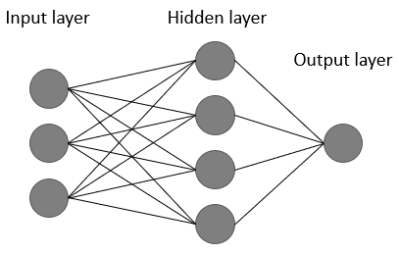
Background: Neural Networks
Each Layer
Takes in many inputs
Can have one or more hidden layers
Can have one or more outputs

Slide 9
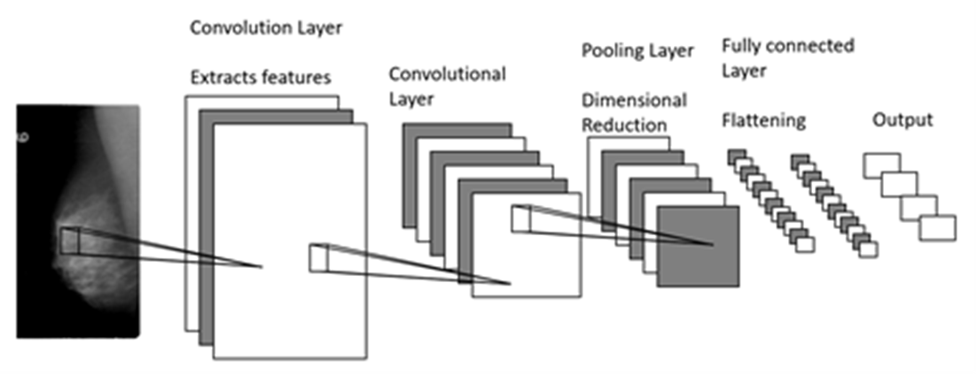
Background: Neural Networks
Convolutional Neural Network
Uses layered approach

Slide 10
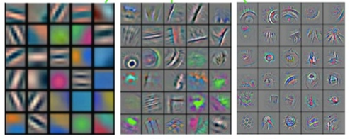
Background: Neural Networks
Convolutional Neural Network
Convolutional Layer applies filters
Pooling is used to reduce computational complexity
Drop out reduces overfitting by hyperactive neurons
Fully connected layer transform network results to the final output

Slide 11
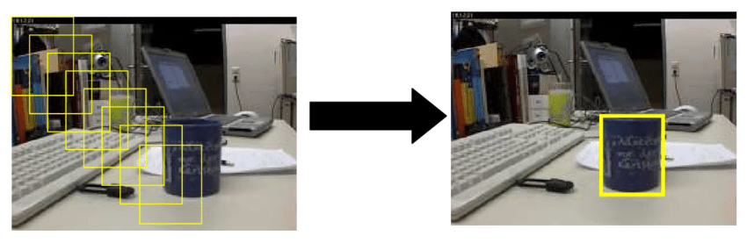
Background: Neural Networks
Object detection
Sliding window detector

Slide 12
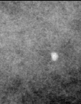
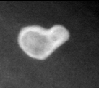
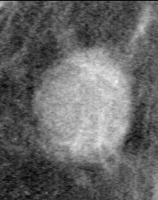
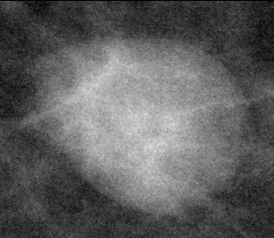
Background: Data
Curated Breast Imaging Subset of DDSM
Breakdown,
100 Full Mammograms for Object detection
2866 images for Training
744 images for Validation

Slide 13
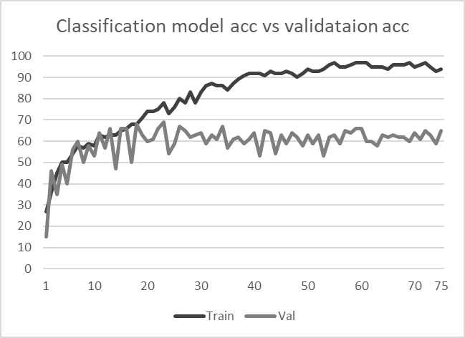
Method
Four Fully connected Convolutional layers (10 - 80 Filters per layer)
One Flattening layer
One Pooling layer

Slide 14
Method
75 Epochs (Iterations)
Peaked at 68% Classification /Validation Accuracy

Slide 15
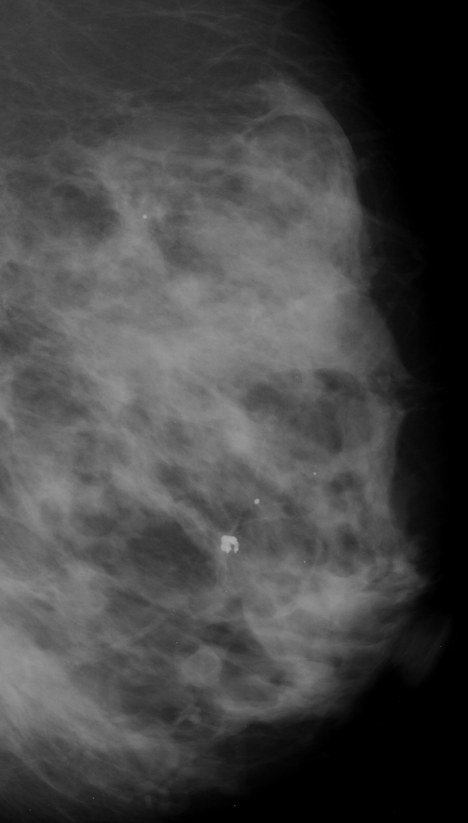
Results
46% Detection rate
20% calcification
26% Masses
17% Benign
29% Malignant
64% Classification rate
2% Wrong type
34% Wrong Pathology

Slide 16
Ethics
Responsibility for False Positives/Negatives
Privacy Concerns for data sets used to develop our model
Is it a tool or a crutch?

Slide 17
Future Works
Utilize more cutting edge CNNs (ResNet)
Developing a system to use Medical images without converting them first
Using a multi-discipline team

Slide 18
Conclusion
Other studies have achieved better results (80%-90%) in limiting their approach to classification or detection.

Slide 26
Last Slide
Fade to black after 15 seconds

